Slide 1
Žiniatinklio paieškos rezultatų kokybės vertinimas
Parengė: Marius Krajauskas, Paulius Savickas
IFAi-2 grupė

Slide 2
Ieškodami informacijos ne visada randame to ko ieškome
Svetainių kūrėjai savo puslapiuose naudoja raktinius žodžius, kurie nesusisiję su puslapio turiniu.
Notes:
● System-centred evaluation levels: Engineering level (e.g., hardware or software
performance), input level (coverage of the designated area), and processing level
(e.g., performance of algorithms ).
● User-centred evaluation levels: Output level (interaction with the system, feedback),
use and user level (wh tasks are raised), and social level (which takes into account the impact on the
environment).ere questions of application to
In our opinion, this also applies to the evaluation of search engines. Only a
combination of both, system and user-centred approach can lead to a clearer picture
of the overall search engine quality .

Slide 3
Kasdieninė informacijos paieška
Dažniausiai vykdomos paieškos yra 3 tipų:
Svetainės/vietos paieška
Informacijos paieška
Potencialių pirkinių paieška
Notes:
http://www.wordstream.com/blog/ws/2012/12/10/three-types-of-search-queries#transactional
A navigational query is a search query entered with the intent of finding a particular website or webpage. For example, a user might enter "youtube" into Google's search bar to find the YouTube site rather than entering the URL into a browser's navigation bar or using a bookmark. In fact, “facebook” and “youtube” are the top two searches on Google, and these are both navigational queries.
Visiting a pre-determined destination and sourcing the “correct” website URL.
Navigational searches are performed with the intent of surfing directly to a specific website. In some cases, the user may not know the exact URL, and the search engine serves as the "White Pages", passing along the (hopefully) correct location.
Wikipedia defines informational search queries as “Queries that cover a broad topic (e.g., coloradoor trucks) for which there may be thousands of relevant results.” When someone enters an informational search query into Google or another search engine, they’re looking for information – hence the name. They are probably not looking for a specific site, as in a navigational query, and they are not looking to make a commercial transaction. They just want to answer a question or learn how to do something.
Informational Searches
Researching non-transactional information, getting quick answers and ego-searching.
Informational searches involve a huge range of queries from finding out the local weather, getting a map and directions, to finding the name of Tony Starks' military buddy from the Iron Man movie or checking on just how long that trip to Mars really takes. The common thread here is that the searches are primarily non-commercial and non-transaction-oriented in nature; the information itself is the goal, and no interaction beyond clicking and reading is required.
A transactional search query is a query that indicates an intent to complete a transaction, such as making a purchase. Transactional search queries may include exact brand and product names (like “samsung galaxy s3”) or be generic (like “iced coffee maker”) or actually include terms like “buy,” “purchase,” or “order.” In all of these examples, you can infer that the searcher is considering making a purchase in the near future, if they’re not already pulling out their credit card. In other words, they’re at the business end of the conversion funnel. Many local searches (such as “Denver wine shop”) are transactional as well.
Transactional Searches
Identifying a local business, making a purchase online and completing a task.
Transactional searches don't necessarily involve a credit card or wire transfer. Signing up for a free trial account at Cook's Illustrated, creating a Gmail account, or finding the best local Mexican cuisine (in Seattle it's Carta de Oaxaca) are all transactional queries.

Slide 4
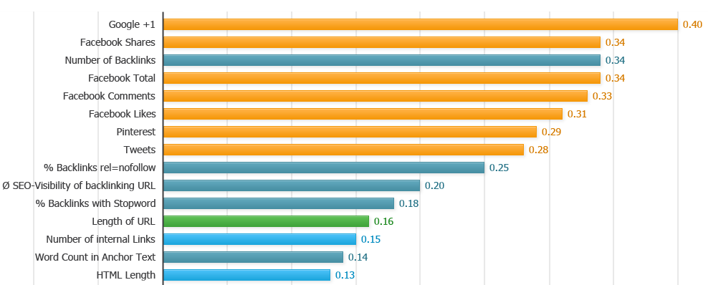
Google paieškos rezultatų reitingavimo faktoriai
Notes:
http://moz.com/blog/searchmetrics-ranking-factors-2014

Slide 5
Paieškos rezultatų kokybė – tai rezultatų tinkamumas vartotojo poreikiams pagal šiuos kriterijus.
Greitas norimo dalyko radimas

Slide 6
Notes:
http://www.entrepreneur.com/article/226884

